Slide 1



Olist Store Analysis
Project By-
Group 4
Mr. BHIMASHANKAR B BABALAD
Mr. KABIR INAMDAR
Mr. URVESH R PATIL
Ms. GAYATRI VERMA
Mr. PRASHANT R KOR

Slide 2
Olist Store Analysis
Domain: E-Commerce
Overview:
This is an e-commerce dataset of orders made at Olist Store. Its features allows viewing an order from multiple dimensions: from order status, price, payment and freight performance to customer location, product attributes and finally reviews written by customers.
Task:
As a data analyst our task was to generate some KPI's from the data we had been given in the form of 9 CSV files
We performed an analysis on the dataset of Olist Store and drawn 5 KPI's regarding Payment stats, Payment type, Delivery days, Review scores and their relation to each other with their effect to solve the business problem faced by the store and to help them in taking better business decisions.
Tools Used:
Excel, Power Bi, MySQL, Tableau

Slide 3
Key KPI’ s
Weekday Vs Weekend (order_purchase_timestamp) Payment Statistics
Number of Orders with review score 5 and payment type as credit card.
Average number of days taken for pet_shop
Average price and payment values from customers of sao paulo city
Relationship between shipping days Vs review scores.

Slide 4
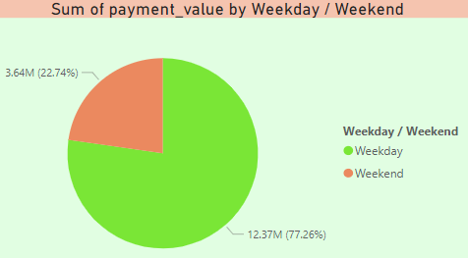
Weekday Vs Weekend
▶ Analyzed Weekday Vs Weekend Payment Statistics, we have got total payment for Weekend 22.74% and Weekdays 77.26%.
▶ Analyzed the year wise average delivery time for weekend and weekdays. As we observed year 2018 has better performance. It is improving year by year.
▶ Also analyzed the weekend vs weekdays order count, observed the more order counts in 2018 for Weekday and weekend.
▶ Analyzed the payment value, and observed that weekday is greater than weekend payment value.

Slide 5
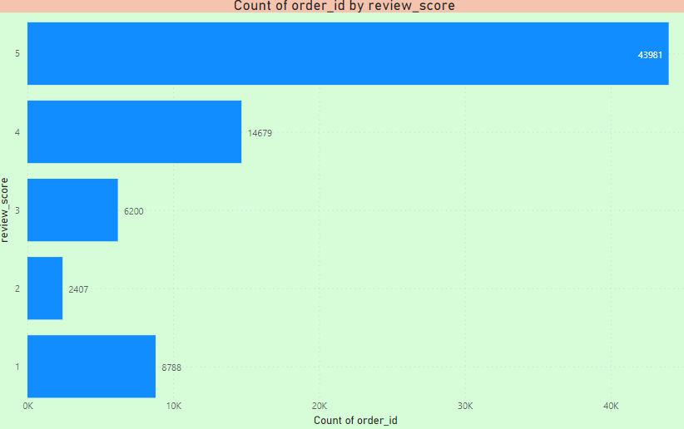
Number of Orders with review score payment type
▶ Total orders for Review Score-5 and Payment Type-Credit Card is 43981.
▶ If we analyze more on Payment Type then Credit Card is widely used as compared to others with number of order 76055. And Lesser for Debit Card which is 1522.
▶ Total Orders with Review Score 5 is '57328 which is highest among all ratings. This clearly shows the products are of Worthy Purchase but Score 1 is on 3rd number describes there is improvement needed for
some of the product.

Slide 6
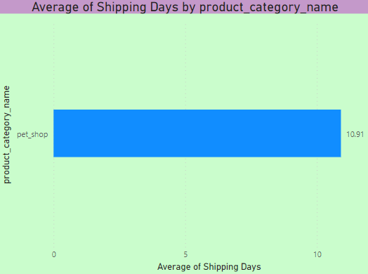
Average number of days taken for pet_shop
▶ We have observed that the average delivery time taken for product category 'pet shop' is 11 days which is fine compared to other product categories as they have taken too much time.
▶ It can also be seen that the average delivery time over the years for product category 'pet shop' is declining from 2016 to 2018 which shows that the delivery has been done quickly.
▶ We have also observed that the city 'Sao Pauli' has ordered the maximum no. of times , followed by 'Rio de jeneiro' and 'Belo horizonte' for product category 'pet shop' so we can expect to have more number of orders from these cities later
▶ Top 3 products that took the least delivery time are 'artes_e_artesanato' , ' fashion_roupa_infa' and 'la_cuisine' which indicates that these products' delivery has been done efficiently
▶ Top 3 products with maximum delivery time are 'movies_excritorio' , 'fashion_calcados' and ' casa_conforto_2'. This shows that proper check is required for the delivery time in these products.

Slide 7
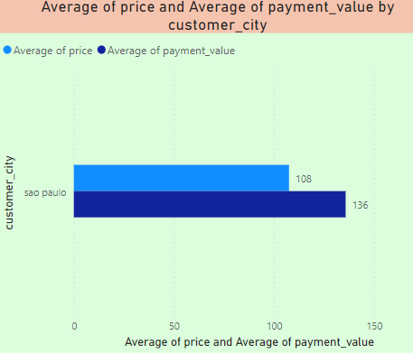
Average price and payment values
▶ We have observed that the average Payment value and average Price value of Sao paulo city the average Payment value of Sao paulo city is 136 and average Price value is 108.
▶ We analyzed that year wise average Payment value average Price value of Sao paulo city is decreasing
▶ So, either we can increase the prices of the products or we can add costly products for purchase to increase the revenue of the company.

Slide 8
Conclusion
▶ We can provide different discounts in weekday and weekend using the insights to improve the sales.
▶ We may work on delivery days so that the review score will rise in a positive way, and we can give fantastic deals for various forms of payment so that they rise in comparison to credit card payments.
▶ The average delivery time for items from pet shops is now 11 days, we must reduce this time and may do so by entering into a contract with additional local vendors. This will result in a shorter delivery time and higher customer satisfaction.
▶ Sao Paulo City has higher average costs and payment values than other cities, the survey claims. It is essential to evaluate price and payment values between cities in order to identify potential development locations and encourage industrial expansion.
▶ According to studies, delivery days and review scores are correlated, thus we must focus on shipping days in order to improve our review scores.

Slide 9


